Slide 1






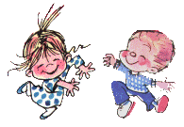

Welcome to class

Slide 2


WARM UP

Slide 3


☞ School things

Slide 4







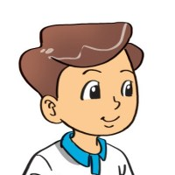


Unit 8: This is my pen
Lesson 1:Part:1,2,3

Slide 5




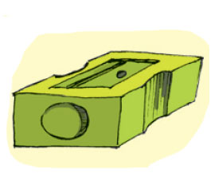


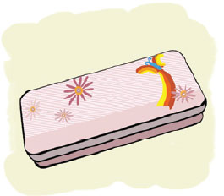
. New words
pencil: bút chì
pencil case: hộp bút
school bag: cặp sách
notebook: vở ghi
pencil sharpener:
gọt bút chì

Slide 6

☺ Game: Crocodile

Slide 7

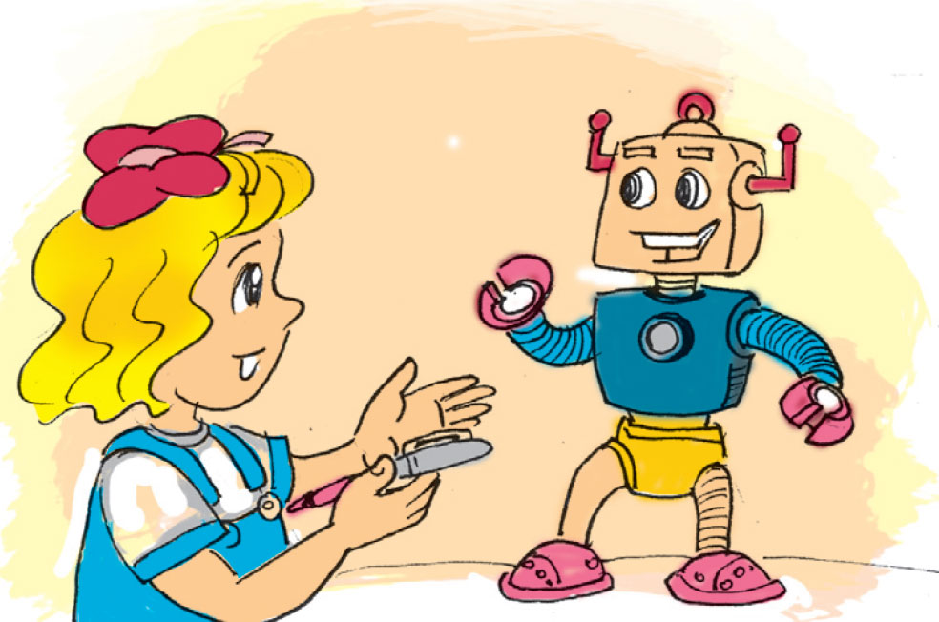
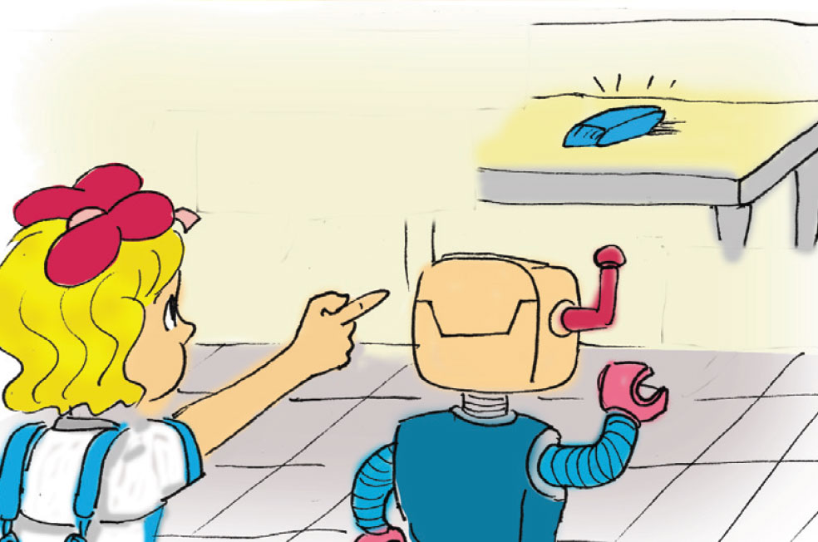

❶, Look, listen and repeat
This is my pen
Is it?
That's my
rubber.
Yes, it is.
Yes, it is.
Is it?

Slide 8

Model sentence
This is my pen
That is my pen
This is = This’s
That is = That’s

Slide 9


❷ Point and say
This is my__
a
b
That is my__
d
e
c

Slide 10
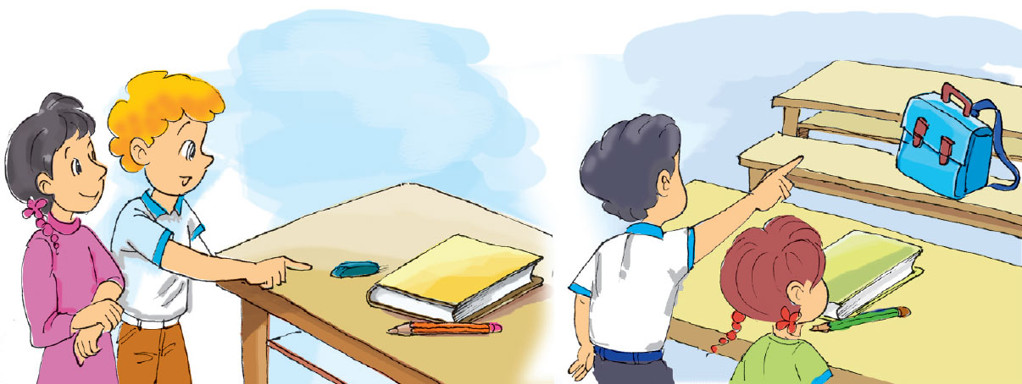
That is my__
❸ Let’s talk
This is my__

Slide 11

`

